Slide 1




Food Ordering System
A DBMS Project Prototype
GROUP MEMBERS:
Anant Jangid --- 05
Akansh Singh--- 32
Aarya Chaudhari —
Abhinav — 48
Abhishek Singh ---

Slide 2

🚨 PROJECT OVERVIEW
A full-stack web application simulating a food ordering platform.
Customers: Browse restaurants, order food, track orders.
Restaurants: Manage menus and view incoming orders.
Delivery Partners: View assigned orders.
Admin: Oversee the entire system.
💡 TECHNOLOGIES USED
Database: MySQL
Backend: Node.js, Express.js
Frontend: HTML, CSS, JavaScript

Slide 3
🎯 DATABASE SCHEMA – CORE TABLE
Users
Stores customer info: name, email (unique), phone, password.
user_id (PK)
2. Restaurants
Stores restaurant details.
restaurant_id (PK)
3. Food_Items
Stores menu items, price, etc.
item_id (PK)
restaurant_id (FK)Links item to its restaurant.
4. Delivery_Partners
partner_id (PK)
5. Orders
order_id (PK)
user_id (FK) , restaurant_id (FK) , item_id (FK) , partner_id (FK)

Slide 4
THE ORDER TABLE – THE HEART OF THE SYSTEM
Purpose: The main transactional table. One new row per order.
Key Columns:
order_id (PK)
user_id (FK)-> References Users
restaurant_id (FK) -> References Restaurants
item_id (FK) -> References Food_Items
partner_id (FK) -> References Delivery_Partners
Quantity , total_price , status.
Data Integrity:
Foreign Key constraints (ON DELETE RESTRICT) ensure an order can't exist if its user, restaurant, or item is deleted.

Slide 5
Start Transaction.
WHY USE A STORED PROCEDURE ?
Encapsulation: Hides complex logic (check stock, insert order, update stock) in one object.
Performance: Pre-compiled, so it runs faster.
Security: App only needs permission to execute the procedure, not update tables directly.
💾 CORE LOGIC (IN A TRANSACTION)
Start Transaction.
Lock the item row (FOR UPDATE) to prevent race conditions.
Check stock. If insufficient -> ROLL BACK
INSERT new orders into Order table.
UPDATE stock quantity in Food_Items table.
COMMIT the transaction.
🛠️ ADVANCED SQL: THE Place_Order STRUCTURE

Slide 6
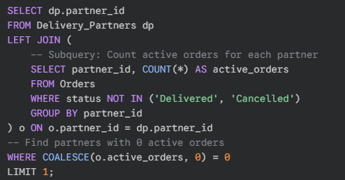

FINDING AN AVAILABLE PARTNER
Challenge: How to efficiently find a delivery partner who is free for a new order?
Solution: A query using LEFT JOIN , GROUP BY and COALESCE to find a partner with zero active orders.
LEFT JOIN ensures we include partners who have no orders (their count will be NULL).
COALESCE(..., 0) is key. It treats NULL counts as 0, allowing us to find truly free partners.

Slide 7
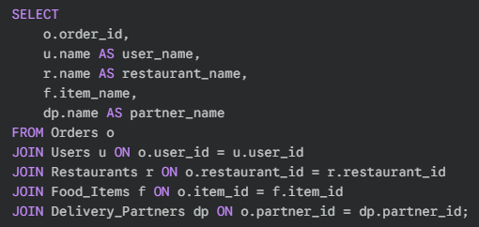
BRINGING IT ALL TOGETHER WITH JOINS
Challenge: The Admin Dashboard needs to show names, not just IDs. (user name, restaurant name, etc.).
Solution: A query using multiple JOIN clauses.
This single query efficiently gathers all required data from five tables for the dashboard display.

Slide 8
Summary:
Project built on a robust, normalized MySQL database.
Uses key DBMS features like Foreign Keys, Transactions, and Stored Procedures for integrity and performance.
Implements complex business logic directly within SQL.
Learning Outcomes:
Practical experience in database design, modeling, and complex SQL.
Understood the importance of Atomicity (Transactions) and Concurrency Control (Locking).
📚COCLUSION

Slide 9
Ṣ
THANK YOU
GITHUB: https://github.com/sasumaa/DBMS-FOOD-ORDERING-SYSTEM

